Slide 1
Humanities – Child Studies
Year 9 or 10

Slide 2
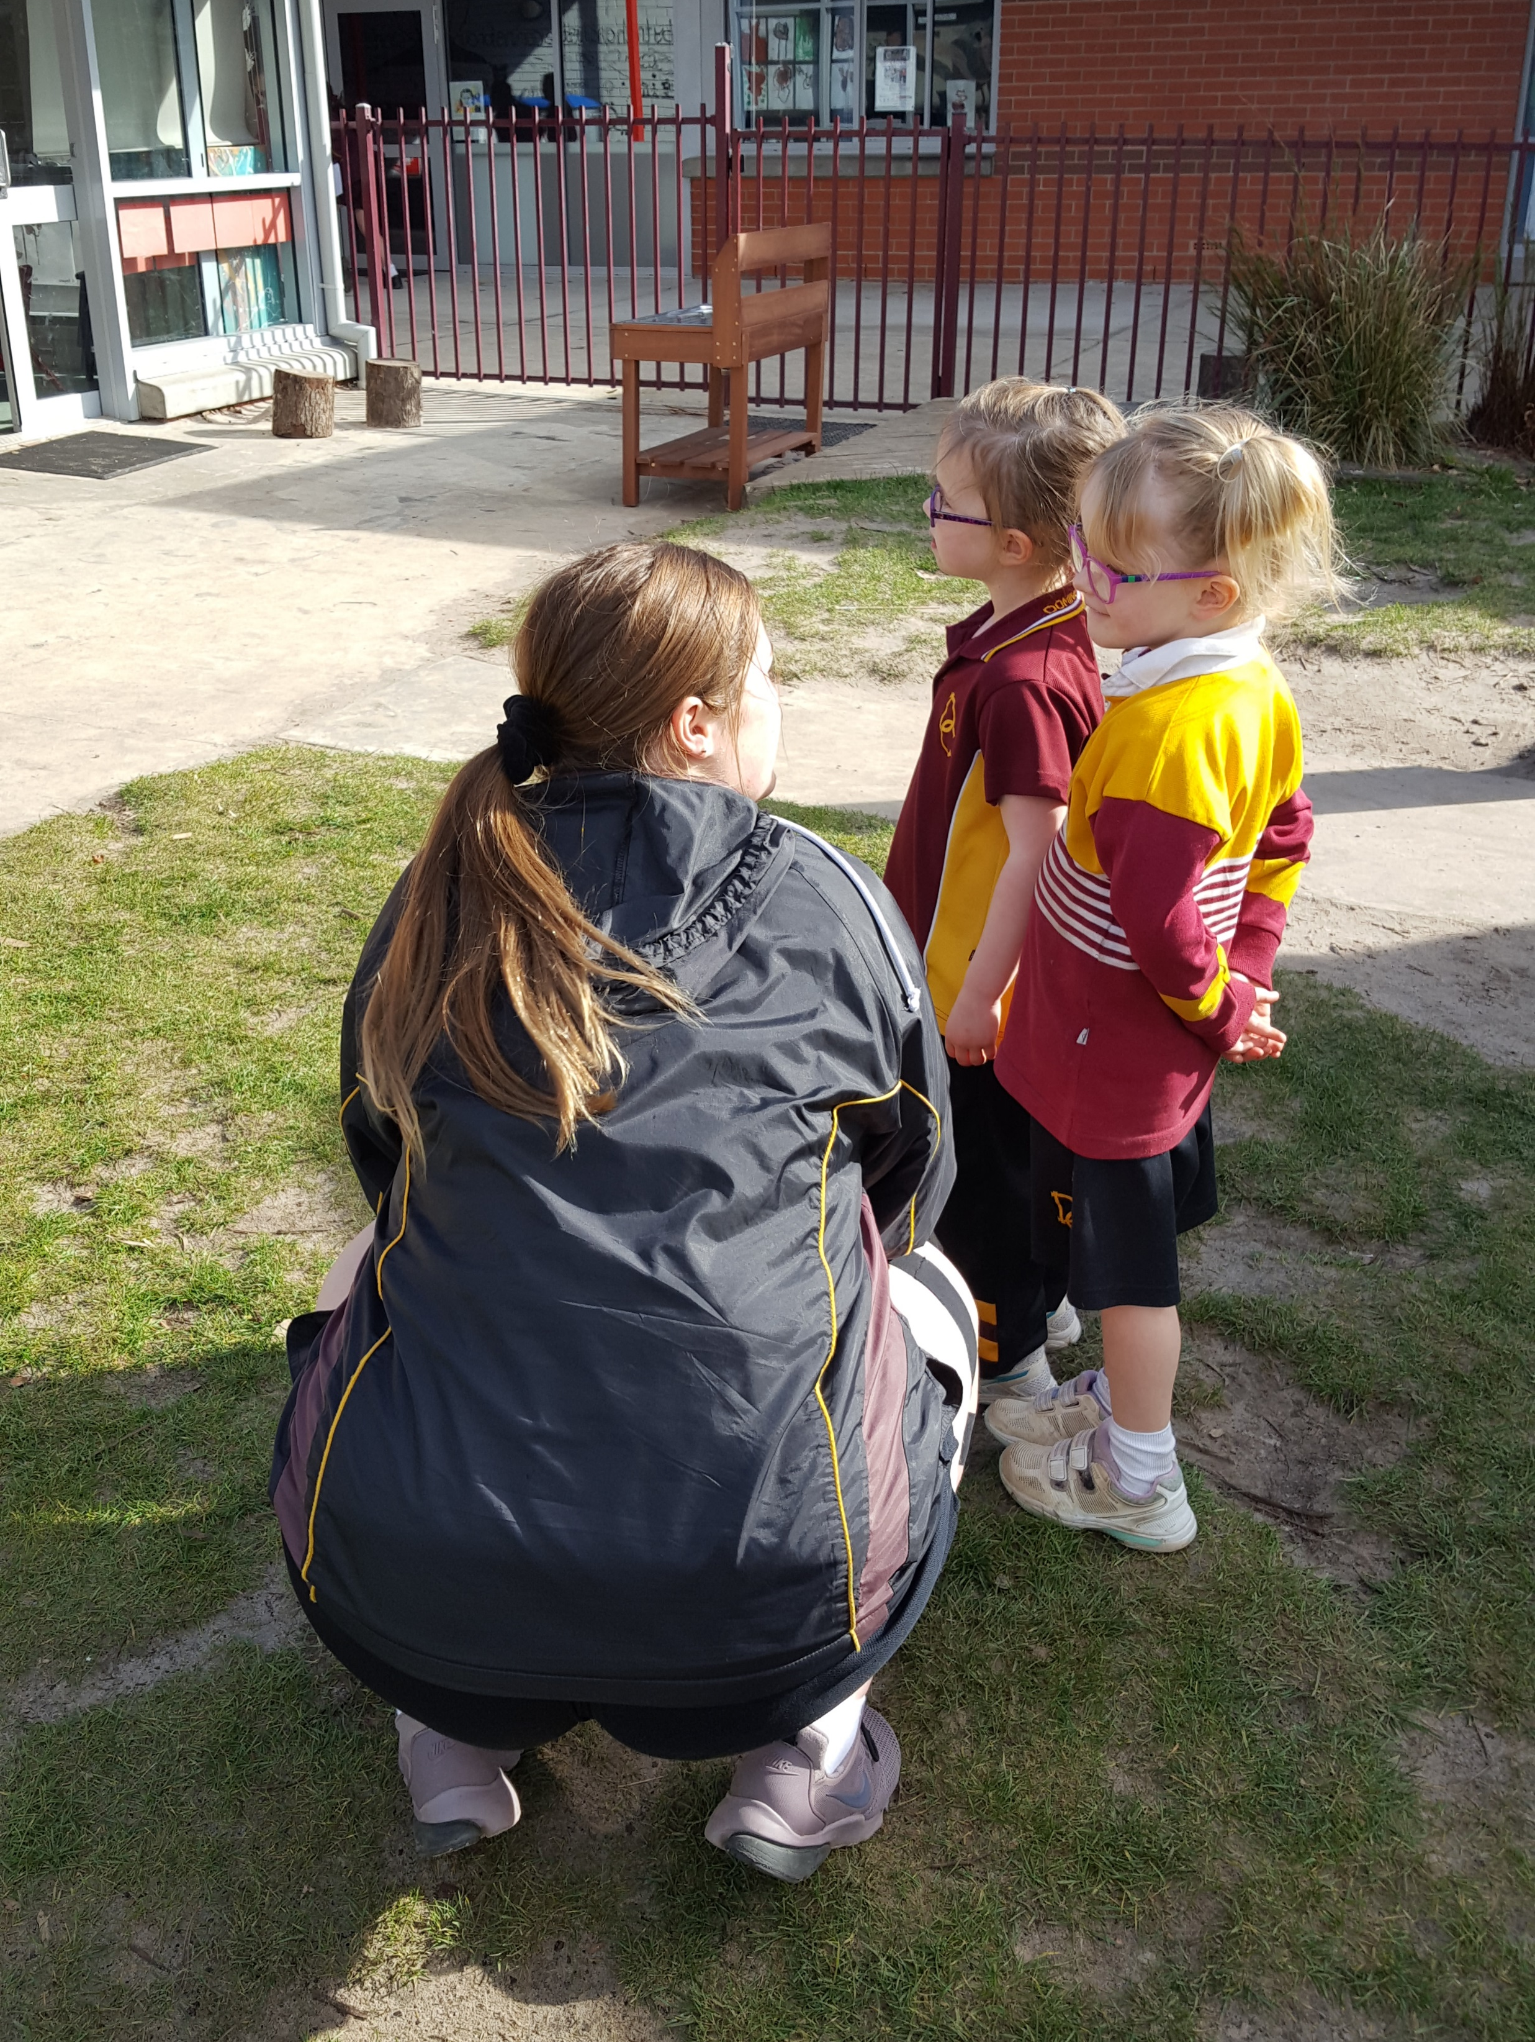
One Year Course
Child Studies is a one year course that can be taken in either Year 9 or Year 10.
The course incorporates both theory and practical components.

Slide 3
What will I study?
Physical, emotional, social and cognitive development of children
Activities which foster child development
Fostering well-being in children
Services provided for parents and children
Positive environments for children

Slide 4
Find out more…
Please feel free to contact Ms Frankie Flanagan, Coordinator of Humanities, at fflanagan@dominic.tas.edu.au.

